Slide 1
Software System Requirements
III. Requirements Elicitation
Week 5
Dr. Abdul Aziz
Department of Software Engineering

Slide 2
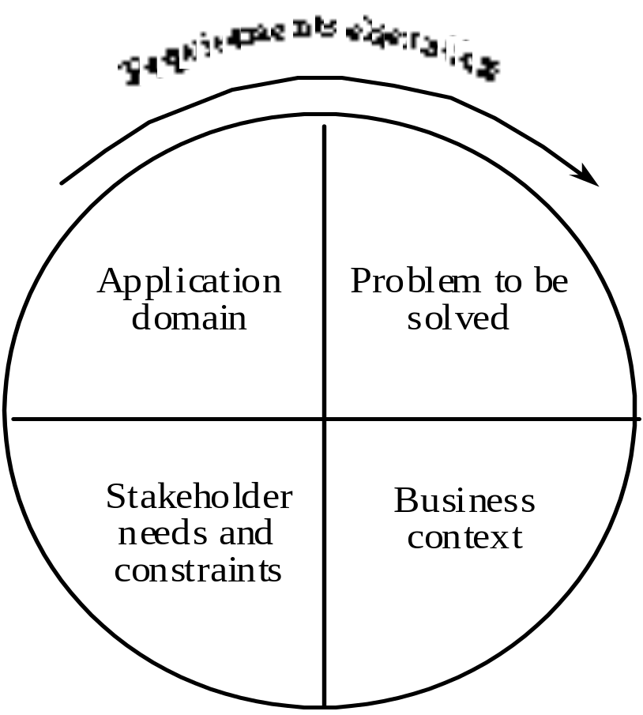
Components of requirements elicitation
RE-3 <number>

Slide 3
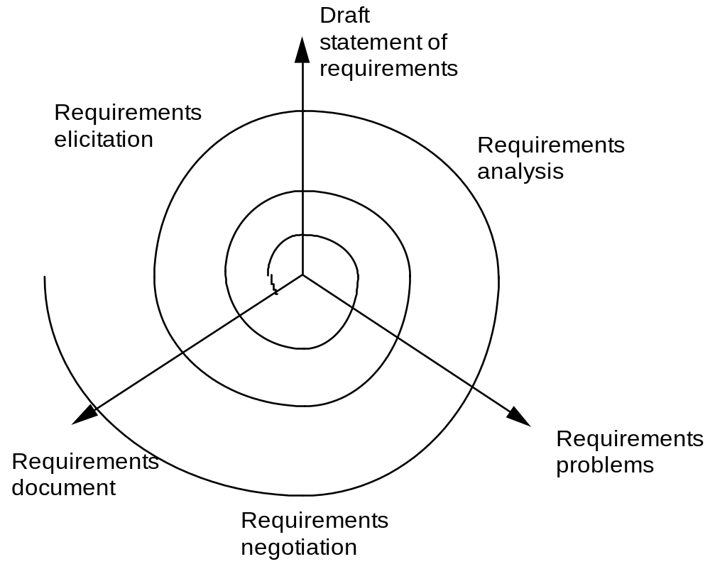
Elicitation, analysis and negotiation
RE-3 <number>

Slide 4
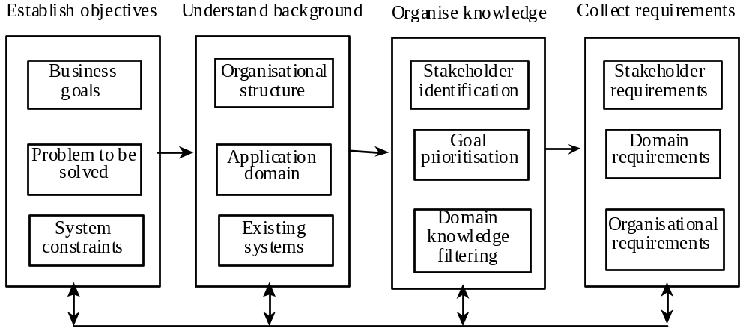
The requirements elicitation process
RE-3 <number>

Slide 5
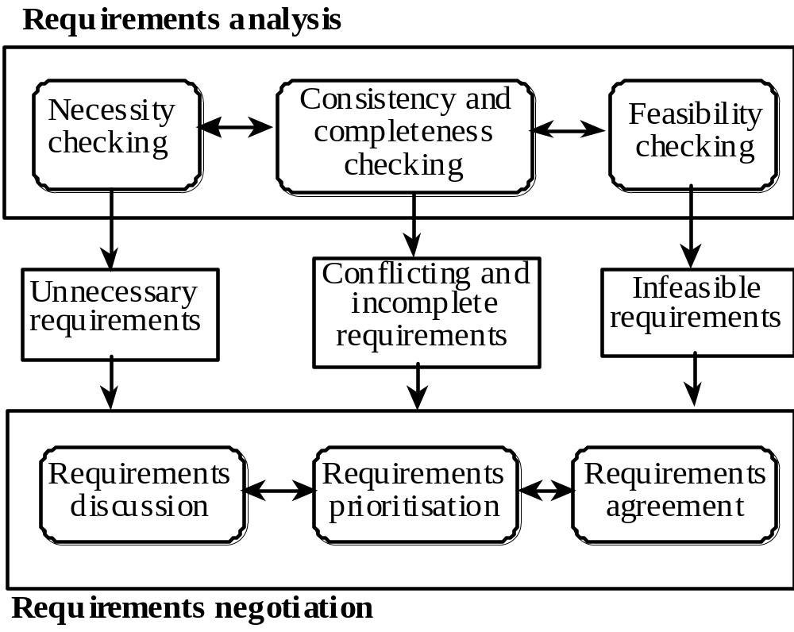
Requirements analysis and negotiation
RE-3 <number>

Slide 6
Analysis checklists
Premature design
  Does the requirement include premature design or implementation information?
Combined requirements
  Does the description of a requirement describe a single requirement or could it be broken down into several different requirements?
Unnecessary requirements
  Is the requirement ‘gold plating’? That is, is the requirement a cosmetic addition to the system which is not really necessary.
RE-3 <number>

Slide 7
Analysis checklists
Use of non-standard hardware
  Does the requirement mean that non-standard hardware or software must be used? To make this decision, you need to know the computer platform requirements.
Conformance with business goals
  Is the requirement consistent with the business goals defined in the introduction to the requirements document? Requirements ambiguity
Requirements ambiguity
  Is the requirement ambiguous i.e. could it be read in different ways by different people? What are the possible interpretations of the requirement?
RE-3 <number>

Slide 8
Analysis checklists
Requirements realism
  Is the requirement realistic given the technology which will be used to implement the system?
Requirements testability
  Is the requirement testable, that is, is it stated in such a way that test engineers can derive a test which can show if the system meets that requirement?
RE-3 <number>

Slide 9
Requirements interactions
A very important objective of requirements analysis is to discover the interactions between requirements and to highlight requirements conflicts and overlaps
A requirements interaction matrix shows how requirements interact with each other. Requirements are listed along the rows and columns of the matrix
  For requirements which conflict, fill in a 1
  For requirements which overlap, fill in a 1000
  For requirements which are independent, fill in a 0
RE-3 <number>

Slide 10
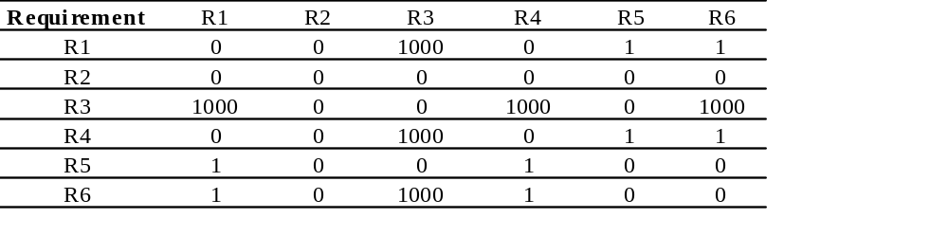
Interaction matrices
RE-3 <number>

Slide 11
REQ Interaction
Quality Parameter
Sort out Requirements
Sequence the requirements
Three types of Requirements:
Independent (0)
Conflict (1)
Overlap (100/1000)
RE-3 <number>

Slide 12
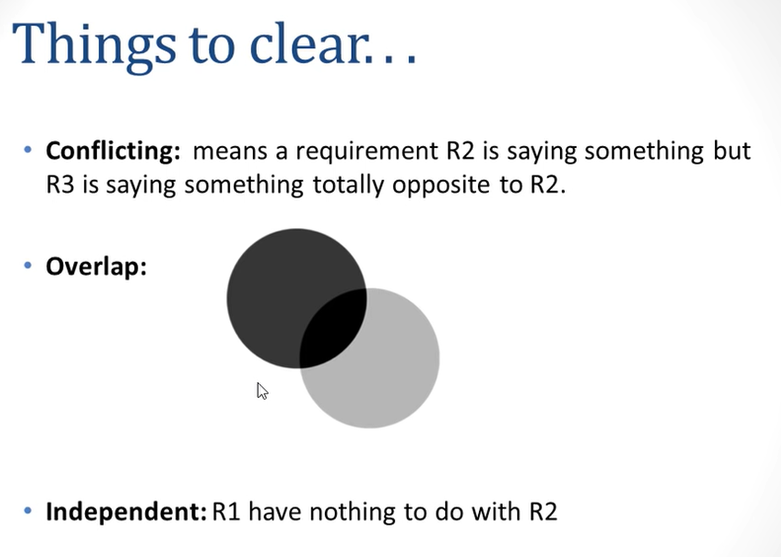

RE-3 <number>

Slide 13
Problems that lead to requirements conflicts.
Voluminous requirements.
Changing requirements and analysts.
Complex requirements.
Conflicting stakeholder requirements.
Changing and unidentified stakeholders.
Changing expectations.
RE-3 <number>

Slide 14
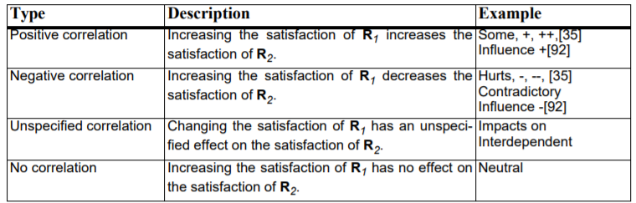
Types of Requirement Relationships
RE-3 <number>

Slide 15
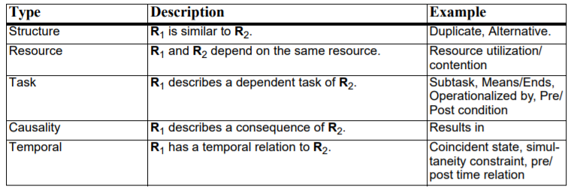
Basis of Requirement Relationships
RE-3 <number>

Slide 16
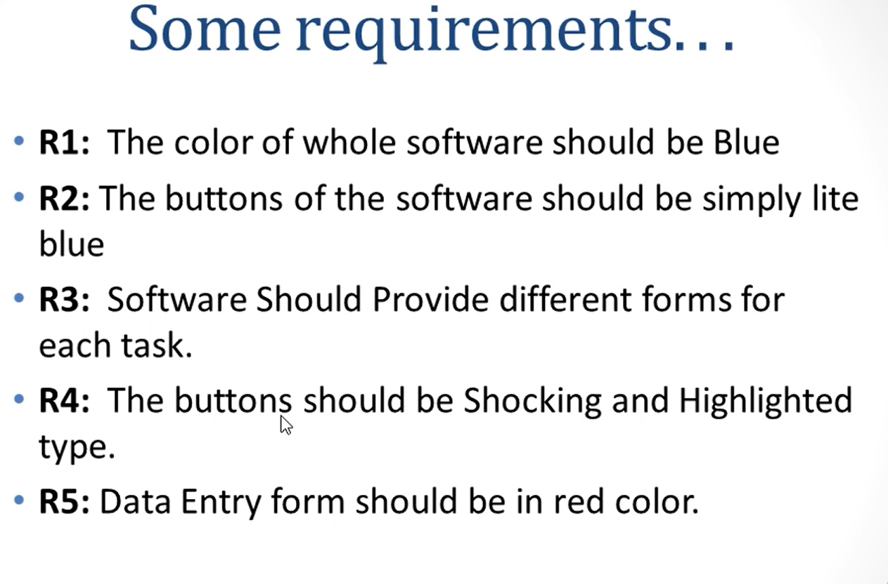
Example
RE-3 <number>

Slide 17
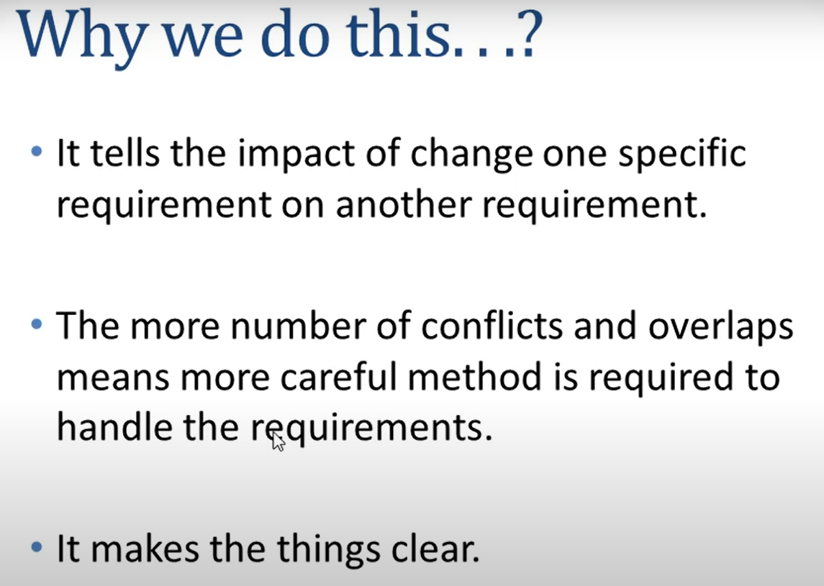
RE-3 <number>

